Slide 1

TIPS Presentation on the 26 June 2024
South Africa in AGOA: Impact and Renewal? -
The past, present and future of Africa – US trade and investment relations:
Recommendations on the Future of AGOA post-2025!
Prof Faizel Ismail
Director: Nelson Mandela School of Public Governance

Slide 2
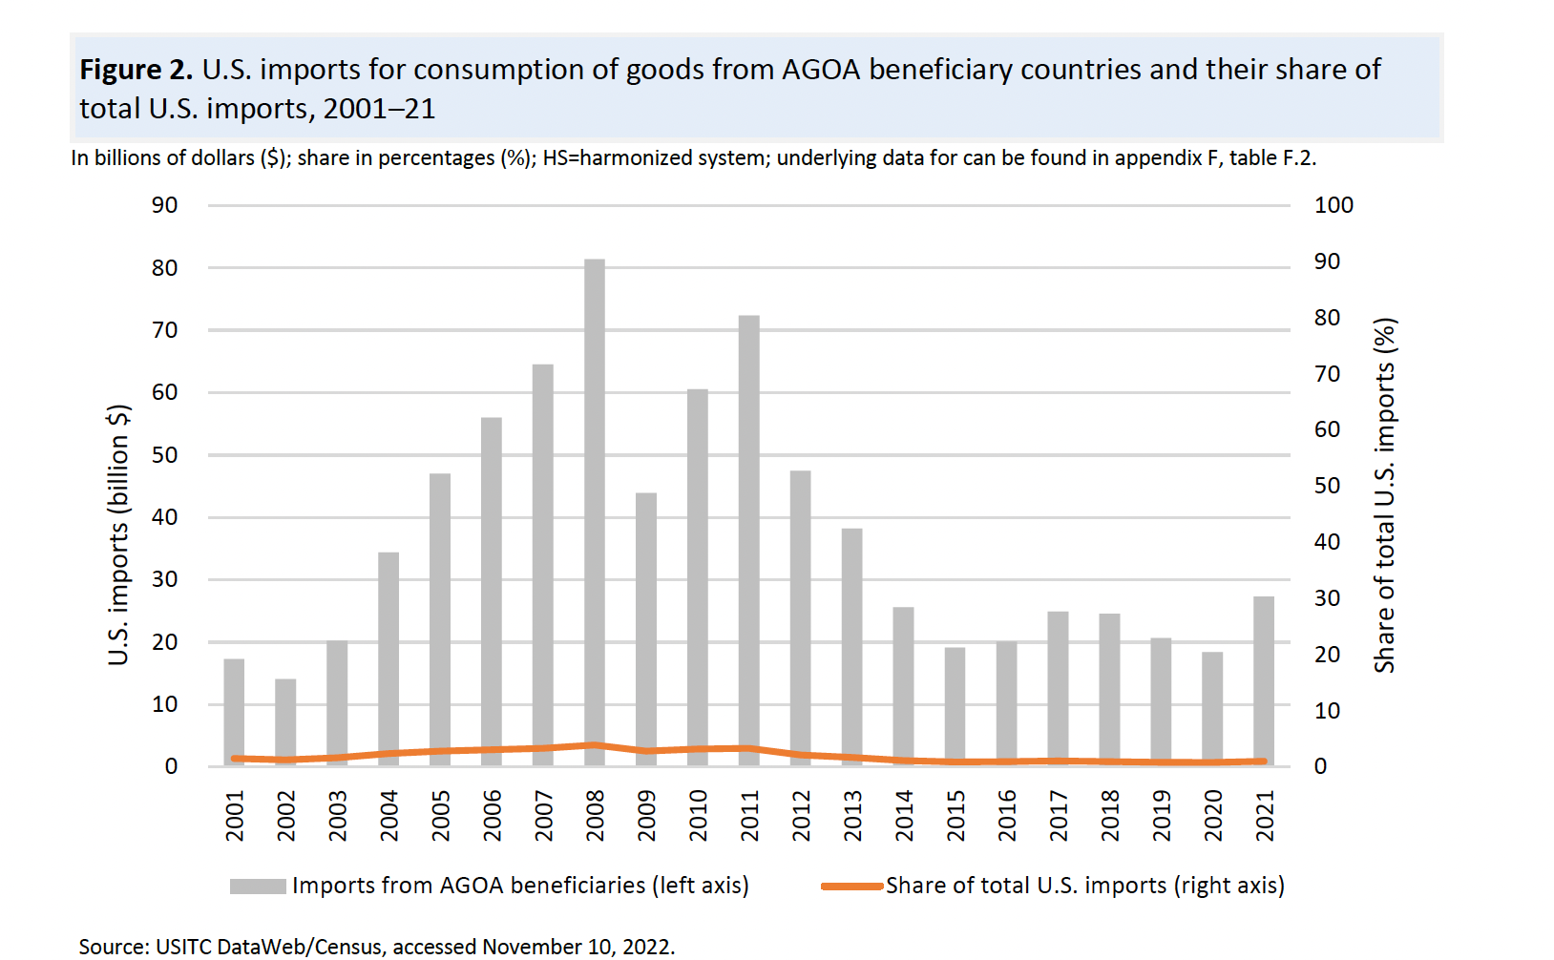
SSA countries exports into the US
A 20-year trend of SSA countries exports into the US reveals
less than 1% of Total US Imports
averaging less than $30 billion over the past 10 years

Slide 3
Which SSA countries were the main AGOA beneficiaries - 2014?
Only 7 other (than South Africa) Sub-Saharan countries exported more than $100 million to the US:
Kenya ($424); Lesotho ($350 million); Ghana ($305 million); Mauritius ($280 million); Namibia ($261 million); Ethiopia ($192 million), and: Cameroon ($130 million).
Kenya, Lesotho and Mauritius have succeeded in using AGOA to expand their clothing and textile exports to the US
However, AGOA beneficiaries still represent less than 1 percent of total US imports of apparel.

Slide 4
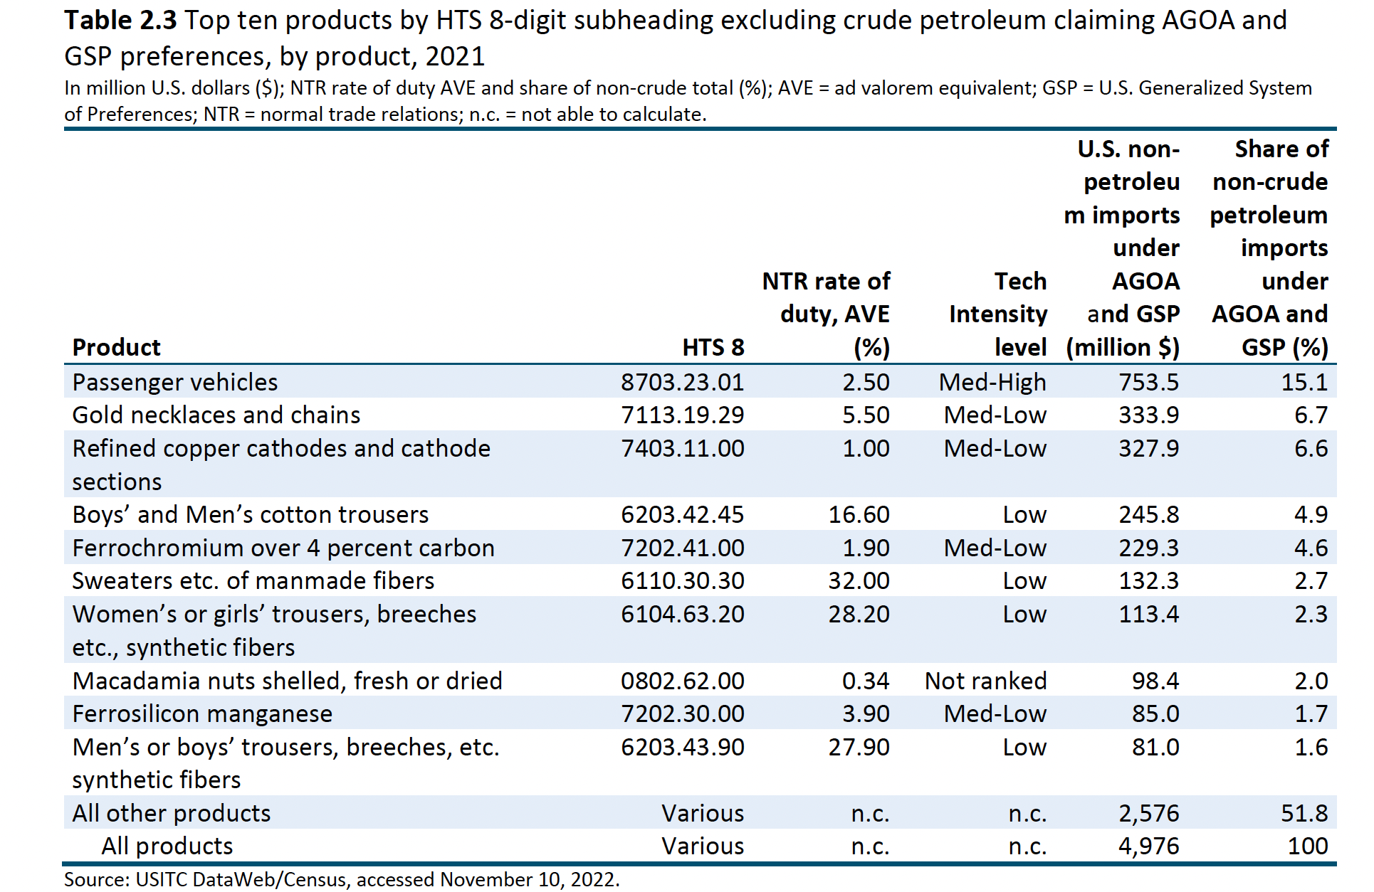
Which products benefitted the most?
Vehicles from SA was the biggest export product!

Slide 5
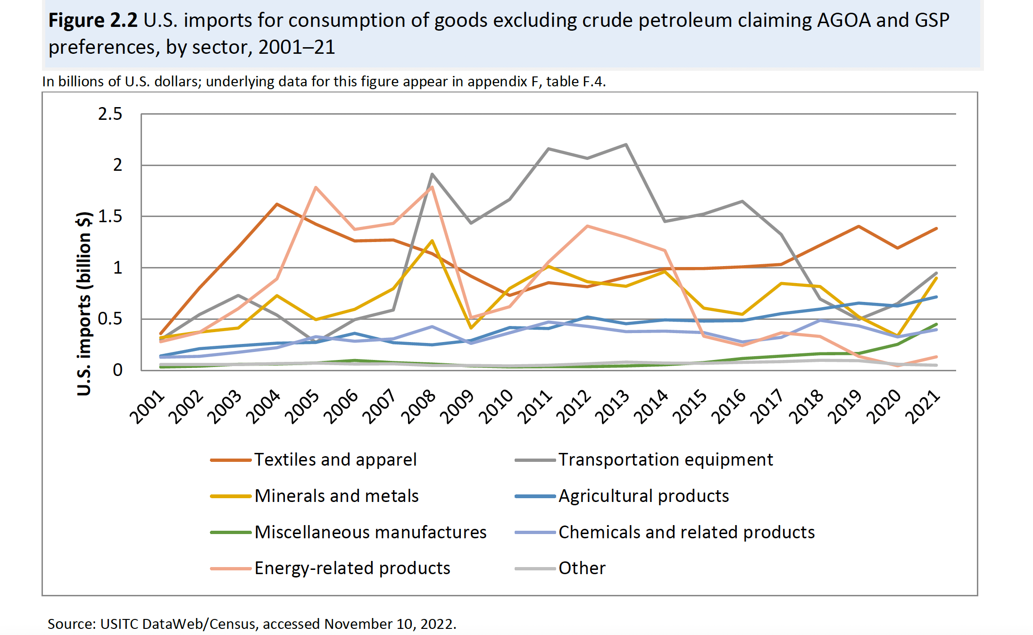
Which sectors benefitted the most?
Textiles and Apparel – benefits the most!

Slide 6
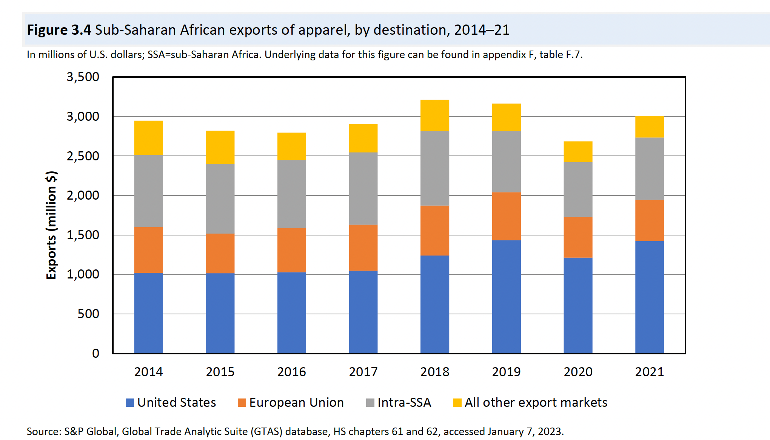
Most SSA Exports of Apparel go to the USA

Slide 7
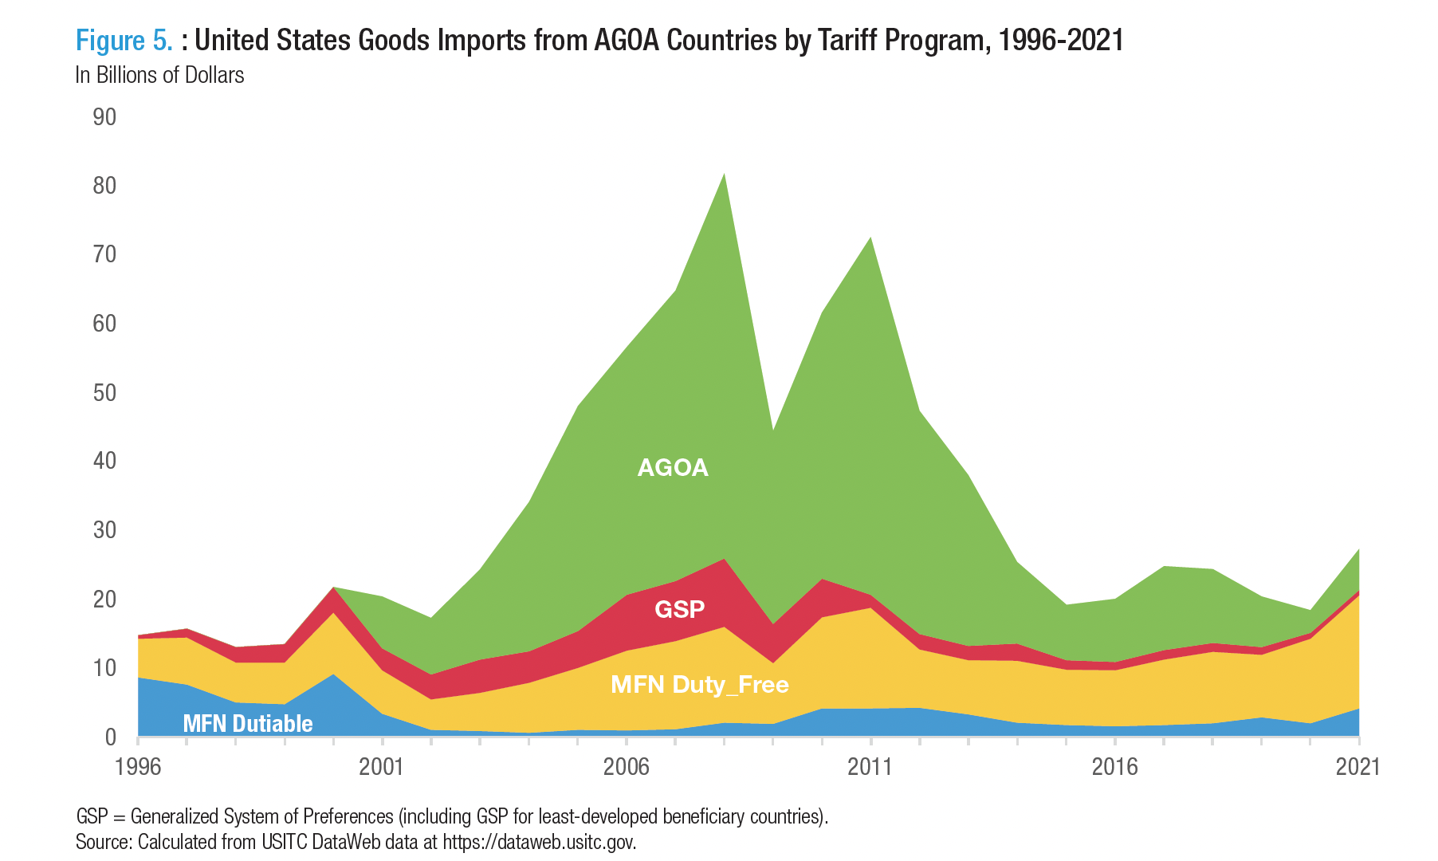
AGOA benefits have been falling relative to Duty Free (NTR) US Imports

Slide 8
Part 7
US Strategy Towards Africa

Slide 9
US Strategy Towards Africa
“It is impossible to meet this era’s defining challenges without African contributions and leadership. The region will factor prominently in efforts to: end the COVID-19 pandemic; tackle the climate crisis; reverse the global tide of democratic backsliding; address global food insecurity; strengthen an open and stable international system; shape the rules of the world on vital issues like trade, cyber, and emerging technologies; and confront the threat of terrorism, conflict, and transnational crime”.
White House, US Strategy Towards Sub-Saharan Africa, August 2023

Slide 10
US Strategy Towards Africa: key priorities
Recognize Africa as a geo-politically strategic region – competition with China, Russia etc. (Africa – 28% of UN vote)
Rules of Law and Democracy .. Support for Peacekeeping and Institution building (25 % of World’s population by 2050)
Encourage supply chains in ‘critical minerals’ that are more diverse, open and transparent (30% of Critical Minerals)
Infrastructure Investment – Prosper Africa, Power Africa and Feed the Future, Partnership for Global Infrastructure and Investment (PGII), & digital transformation
Climate Change and Environment, Carbon Sinks and Forests, Adaptation and Resilience (PREPARE) (2nd largest Rainforest)
Pandemic preparedness, CDC and HIV Aids support

Slide 11
A 21st Century US Africa Partnership
Elevate US-African Partnership
Engage more African States
Bolster Civil Society
Transcend Geographic Seams
“address the artificial bureaucratic division between North Africa and sub-Saharan Africa”
The White House, US Strategy Towards Sub-Saharan Africa, August 2023

Slide 12
US – Africa trade and investment lacks ambition and has fallen behind China
China has far surpassed the U.S. as an economic player in Africa.
China is Africa’s largest two-way trading partner, hitting $254 billion in 2021, exceeding by a factor of four U.S.-Africa trade.
China is the largest provider of foreign direct investment, supporting hundreds of thousands of African jobs. This is roughly double the level of U.S. foreign direct investment.
China remains by far the largest lender to African countries
US Institute of Peace
https://www.usip.org/publications/2022/12/10-things-know-about-us-china-rivalry-africa

Slide 13
Part 9
Recommendations on US-Africa relations post-2025

Slide 14
Recommendations on US-Africa relations post-2025
AGOA should be extended permanently, or at least for the next decade (as proposed by UNCTAD)
AGOA beneficiaries should be allowed to cumulate(RoO) with North African countries across all sectors to build regional value chains and deepen implementation of the AfCFTA
US-Africa trade negotiations should be conducted regionally with the AfCFTA playing a key coordinating role so there is no misalignment or undermining of the AfCFTA agreements

Slide 15
Recommendations on US-Africa relations post-2025
AGOA RoO should be made more flexible from the current 35% value added
Some products currently excluded such as agriculture and food products should be included
High tariffs imposed on AGOA beneficiary countries such as in Aluminium and Steel (Sec 232) should be removed

Slide 16
US should recognize AfCFTA as a key negotiating partner
US should change the composition of AGOA in line with its own recognition of the need to modernize its views of Africa to adopt a whole of Africa approach!
“address the artificial bureaucratic division between North Africa and sub-Saharan Africa”.
US – AfCFTA cooperation agreements should prioritize the implementation of the AfCFTA
US should Increase Public and Private sector Investment to build Regional Value Chains in the following sectors: Textiles, Pharmaceuticals, Autos, Logistics infrastructure, Renewable energy, Agro-processing, critical minerals processing and beneficiation and the digital economy.

