Slide 1
Toward an industrial policy for women
V1a
August 2024
TIPS DD on gendering industrial policy

Slide 2
SA’s unique deficits
Employment
Extraordinarily low employment ratio – around 40%, compared to global norm of 60%
  Women at 35% (up from 25% in mid-1990s)
  Men at 45%, and stable
  Black women have much the lowest paid employment levels
Biggest deficit is self- employment – 4% of South African adults are self-employed, compared to 15% in upper middle income countries ex China (24% in China)
Need new support systems and infrastructure to rebuild, not just providing finance and ending apartheid laws
Women face additional barriers around family roles and household infrastructure
Inequality
Big businesses capture bulk of incomes and market – in 2021, 432 companies paid two thirds of company income tax
Amongst the most unequal household incomes in the world
Reproduces in part due huge differences in inherited assets, access to quality education and infrastructure
Class inequalities still align largely with race and gender, despite great progress from 1994
Mining dependency
Minerals, metals and coal
  55% of SA goods exports, compared to 35% (mostly petrol) for other upper middle income countries ex China
  10% of SA GDP and 5% of jobs – almost none for women
Clothing and electronics assembly under 5% of SA exports, compared to almost 15% for other upper middle income countries
Slow growth
  GDP growth equal to peers from 1994 to 2011, recovering from much slower growth in 1980s
  Since then, lagging increasingly behind, especially due to end of mining boom, state capture and infrastructure deterioration
  Virtually no growth in GDP from 2019, compared to 1% a year in Latin America and 2% in other upper middle income countries excluding China
  Means harder to restructure economy to empower historically excluded

Slide 3
Why not just export manufactures?
Asia industrialised by exporting consumer manufactures especially to global North
Benefited majority due to initial focus on labour-intensive industries – clothing and plastic products, then electronic assembly, only more recently auto and capital goods
Able to compete based on
  Cheap labour compared to global North
  Regional development –expanded demand and investment sources, plus synergies on infrastructure
South Africa
  Competing with Asian workers, not US or Europe – pay in SA is around the same as in China
  Competing with established Asian producers to supply retailers and brand names
  Incomparably smaller domestic and regional markets
Only auto assembly and some niche products, mostly linked to mining, have broken into international manufacturing trade
  All capital intensive, with few women workers
  Result: even high exports have not led to substantial new opportunities (auto value chain employs 125 000 max)
Successes in labour-intensive export activities since 1994:
  Horticulture
  Cultural services (entertainment, design)
  Health and education (mostly provided in SA for foreigners)
  Tourism
  Digital and professional services (software, website design, engineering, legal, high-end security, finance)
Trade data systematically undercount services exports, which include (a) services to foreigners provided in SA and (b) services provided in foreign countries from SA

Slide 4
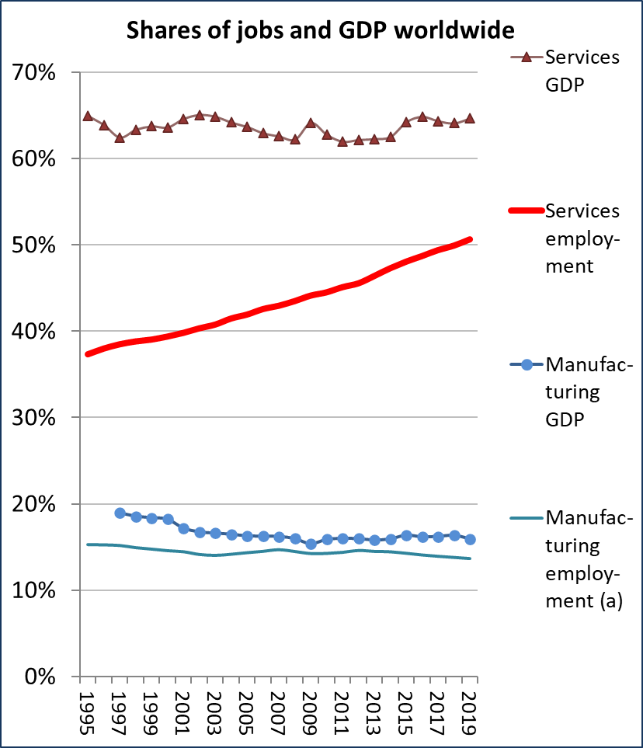
Inclusion and industrialisation
Internationally, services have generated virtually all net new employment since 1995
In China:
  Agricultural employment down from 60% in 1991 to 25% in 2019
  Manufacturing up from 21% to 27%
  Services from 19% to 47%
In SA and globally, services
  Provide pay and conditions on par with manufacturing
  Are knowledge intensive
  Are critical for building human and social capital and national competitiveness
  Are especially important for women’s careers (except for some professional business services)
ILOStat and WDI

Slide 5
An industrial policy for inclusive industrialisation in SA
Prioritise long-term aims of employment, equality, diversification and growth – technological upgrades and exports as means, not ends in themselves
Prioritise innovation where it can generate new opportunities on a mass scale
  Replace risk aversion with risk management
  When is job creation more important than higher productivity?
For established business: Focus on improving government services and holding down input costs

Slide 6
Overcoming the employment deficit
Requires significant changes in
  Sectors and industries supported by government departments
  Scale of support for intermediaries able to reach small businesses in poor communities
  Government systems and rules for risk management and payments
  Systems to ensure support from other agencies – structured engagement and unambiguous prioritisation
Industries:
  Services of all kinds
  Forestry and agriculture, especially contract schemes for smallholders
  Construction including public works schemes, solar installation in townships and home building/upgrading
  Light manufacturing, especially local food systems, clothing (not textiles) and other labour-intensive consumer goods
Innovative clusters and production systems:
  End result: more small producers meeting local needs or feeding into formal VC
  Critical = public, private and social intermediaries that can create ecosystems for small producers – e.g. contracting out in agriculture and forestry, franchising in services such as fast food, tutoring, gardening and cleaning
  Township enterprises that serve the community or work from new commercial, retail and where desirable light industrial sites
  Increase labour intensity in the public services on the model of community health workers and teaching assistants

Slide 7
Support for established industries
Prioritise competitiveness and growth prospects, not rescue operations
Protect against competition (import tariffs, guaranteed offtake/ localisation agreements) only if it supports competitiveness strategies, rather than replacing them
More re-active and responsive stance:
  More reliable and affordable electricity, freight transport, water and broadband – including metros and secondary cities
  More efficient licencing, without sacrificing standards
  Focus on cost cutting, not protection
    Consistent, large-scale measures to ensure rents from commodities go to downstream manufacturers (e.g. soya for poultry; iron ore, coal and scrap for steel; textiles for clothing)
    Incentivise upgrades in work organisation, technologies and product lines

Slide 8
Takeaways
Changes in the way the state functions:
  Unambiguous prioritisation as basis for alignment across the state
  Reallocation of capacity within the dtic
  Management of risks resulting from structural change, rather than just avoiding them
  Address the specific obstacles facing historically excluded, including from gender roles
To address the continued economic subordination of women, industrial policy has to prioritise SA’s unique socioeconomic needs
Walking on two legs:
  Massively scale up programmes to create opportunities and empower our people through innovative programmes
  Help established producers become more competitive, rather than just protecting them from competition

Slide 9
Re a leboha!

