Slide 1
Evaluation of the master plans: A summary
Input to TIPS development dialogue
July 2024

Slide 2
Aims and methodology
Five years since introduction of master plan approach
Evaluation should help identify new opportunities and areas for improvement
Methodology: Review of overall master plans project
  Individual plans analysed as main mode of implementation, with four reviewed in more depth as case studies
  Problem that no published policy document – draw on presentations and speeches
Re-imagined industrial strategy (RIS) documentation only discusses process – for objectives, use the overall dtic vision:
    “A dynamic, industrial, and globally competitive South African economy, characterised by meaningful economic transformation, inclusive growth and development, decent employment and equity, built on the full potential of all citizens.”

Slide 3
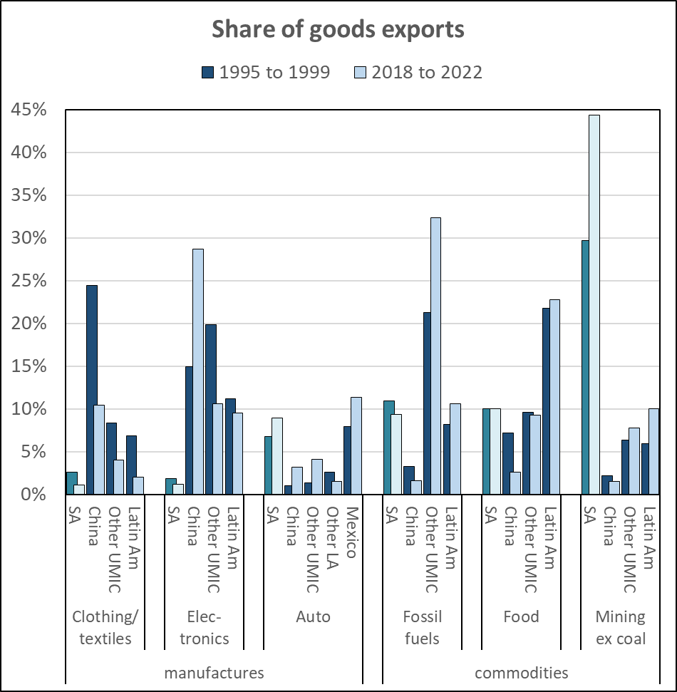
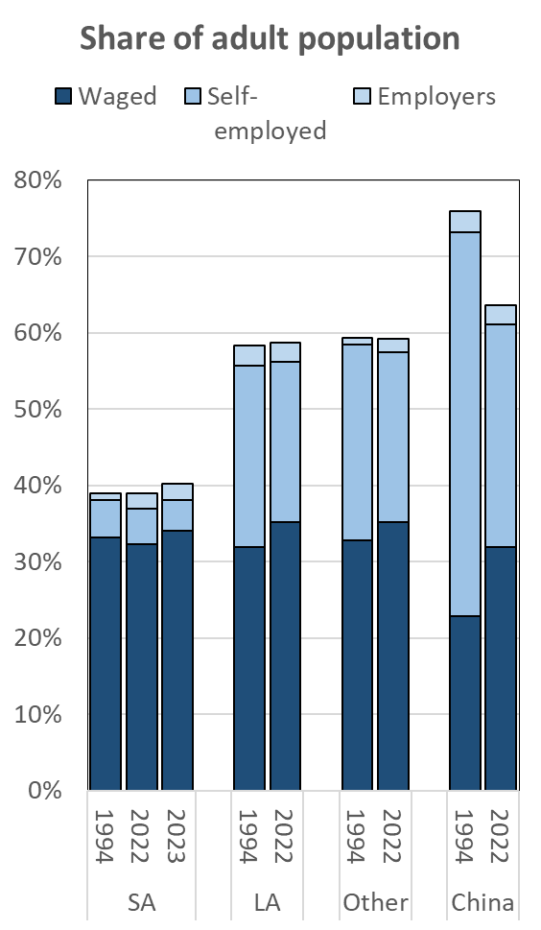
The structural challenges

Slide 4
The master plan project
Five main innovations
  Well-defined aims for industrial policy to guide master plans
  Focus on a few prioritised industries to enable scaled up support
  Close collaboration with industry stakeholders (established business and organised labour) – platforms and engagement are more important than the published document
  Evidence-based approach with on-going evaluation and learning
  Increased resourcing and alignment across the state to implement master plans
Effective theory of change:
Government sets the main impacts and outcomes for industrial policy, and by extension the master-plan project and the master plans for individual industries.
Government identifies a limited number of priority industries that, as a group, can accelerate inclusive growth, by expanding economic opportunities and/or driving faster growth.
For each priority industry, government establishes a platform with formal business and labour to develop joint initiatives to achieve agreed-on aims.
The stakeholders agree on effective actions to support inclusive growth in the industry, testing proposals against the evidence so as to ensure realistic and effective approaches.
The stakeholders set up governance structures to drive implementation effectively while responding to changing conditions and needs.
The stakeholders allocate capacity and resources on the scale required to drive the structural changes required, with alignment across government to implement industry-level measures.
Large-scale, innovative measures accelerate economic growth in the master plan industries, which expands both competitive capacity and economic opportunities

Slide 5
Aims and prioritisation
Aims
  Not specified in re-imagined industrial strategy
  Have to balance
    upgrading established business
    opening up new opportunities through new clusters and producers
  Master plan guides (2023) recommend methods developed to define business needs (Pestel + Porter’s 5 forces), not socio-economic imperatives
Prioritisation
  Original proposal: Identify limited number of industries that can drive structural change as a group
  Prioritisation should enable
    Scaled up resourcing
    Alignment across the state
    Manage lobbying
  Started with list of 13 covering most of the economy; of those:
    6 published;
    4 published but not on list, 3 of which are very small;
    5 underway that not on list and all small except construction

Slide 6
Strategies and measures
Strategic narrative
Imperatives:
  Growth ultimately requires improved competitiveness
  Need to generate opportunities on a mass scale
Master plans:
  Very hard to discern strategic narrative
  Business lobbying for protection, local procurement and better government services
  Not interested in fights around supplier prices and rents (e.g. soya, textiles, iron ore and coal)
  Disruptive technological change is also divisive and difficult for many established businesses (e.g. poultry, steel, EVs)
  Government focused on black ownership and target setting
Use of evidence
No new systems to commission, obtain or use evidence
No clear narrative on cost drivers or inclusion, and little evidence on government and stakeholder proposals
Range:
  Auto: an expert input on broad economic imperatives
  Steel: no visible research base at all
Stakeholders
Only formal business and labour
Working class consumers, most small businesses, jobless and municipalities not represented except through national departments
Master plans
  Did not evaluate impact of tariffs and local procurement on prices and on government services
  Do not open new opportunities for small business on a large scale except in forestry (where not implemented); agreed limits on land reform
Alignment across the state
Project does not specify new platforms or systems (engagement, mandating, dispute settlement, capacity)
No link to government expenditure or SOCs
Master plans
  Do not propose large-scale increases in resourcing but do ask for improvements in infrastructure – limited success in implementation
  Average incentive is around R500 million per industry, compared to R30 billion for auto

Slide 7
Some outcomes
Cannot evaluate impacts due to series of crises from 2020
Relatively small share of economy means that even if reached targets:
  Growth: master plan industries would accelerate from 1,6% to 4,3% - but national growth only up by 0,2%
  Employment: master plan industries would accelerate from 1,1% to 2,0%, but national formal jobs growth would increase by only 0,1%
  Share of adult population with formal employment would climb from 27,9% to 28,2% by 2030
Examples:
  Industry-level platforms have been unable to deal with crises at Eskom and Transnet
  As a group, the master plan industries saw slower increase in import intensity than other industries, but only historic commodity exports climbed significantly (mostly due higher world prices)
  Some industry examples:
    No change to APDP incentive scheme and consequently in local and regional sales, which master plan document saw as central pillar for growth along value chain
    Chicken imports down but domestic production did not increase as fast, while feed prices escalated in 2022 - IQF chicken prices rose 2,6% faster than inflation from 2020 to 2023, and consumption per person fell
    Sugar imports from eSwatini fell while price restraints were in place, but since then have increased as producer price increase jumped 25% in 2023
    In steel, debates over scrap underscore tensions between established and emerging business
    Similar issues around rebate for textiles – progress on woven material but delays on knits

Slide 8
Impact on socio-economic groups
Established formal business:
Benefits: Government works to improve ecosystem; import protection; improved government services and financing
Costs: Engagement; support for black-owned businesses; price restraint in sugar and poultry; funding for industry institutions and funds; retailer commitment to local procurement in sugar and CTFL
Risks: Process fails due lack of government alignment and socio-political pressures
Small and emerging business:
Benefits: Accelerated growth and some targeted support
Costs: Capacity to engage
Risks: Measures favour established business e.g. in tariffs on inputs and provision of infrastructure
Unemployed/informal:
Benefits: Accelerated growth may open some opportunities and increase public revenues
Risks: Reinforce path dependency, so government less likely to drive changes in production structure or ownership to expand opportunities on scale
In practice, ignore most labour-intensive industries, especially services; limits on land reform
Working-class consumers:
Benefits: Growth increases incomes and employment; producers may use relief from competition to upgrade production, ultimately moderating prices
Costs: Higher tariffs raise prices on some consumer staples, notably poultry and clothing
Government departments and agencies
Benefits: Growth increases incomes and employment; producers may use relief from competition to upgrade production
Costs: Capacity to manage process, including lobbying by established businesses and resources for industry-level structures; resourcing for specific measures
Risk: Disappointed partners if cannot deliver

Slide 9
Some proposals
Long-term targets (2035) for industrial policy that measure progress in terms of:
  stepped up employment and self-employment (faster than GDP growth);
  Reduced mining dependence
  Ambitious but realistic growth targets
More rigorous selection of master plan industries
  As group should help achieving long run aims
  Significant improvement in resourcing once selected
Every master plan should commission a research-based strategic narrative that identifies:
  cost drivers, including an evaluation of input pricing, technologies, skills and infrastructure;
  structural changes to scale up employment and self employment – innovations around products and who pays, ownership and employment systems, intermediaries
Government engagement:
Streamline governance structures, delegate more, and mandate national priorities for the industry
Agree on measures with all affected government agencies before sign off, including representation on platforms (which has costs)
Formally evaluate impact on consumers, small business and municipalities before finalising any proposals
Formalise systems for industries not included in the master plans, especially when they face a crisis
Define the roles of sector desks – advocacy/unblocking, monitoring, policy development?

Slide 10
Implications for industrial policy
Industrial policy has to meet SA’s unique needs
Specify long-term goals to help ensure we stay on the right track
Changes in the way the state functions:
  Unambiguous prioritisation of a few key aims and programmes as basis for alignment across the state
  Reallocation of capacity within the dtic
  Management of risks resulting from structural change, rather than just avoiding them
Walking on two legs:
  Massively scale up programmes to create opportunities and empower our people through innovative programmes (products, ownership, financing, intermediaries)
  Help established producers become more competitive, rather than just protecting them from competition

Slide 11
Re a leboha!

